Slide 1
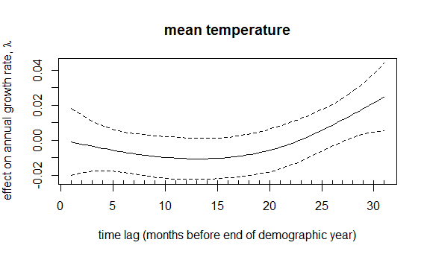
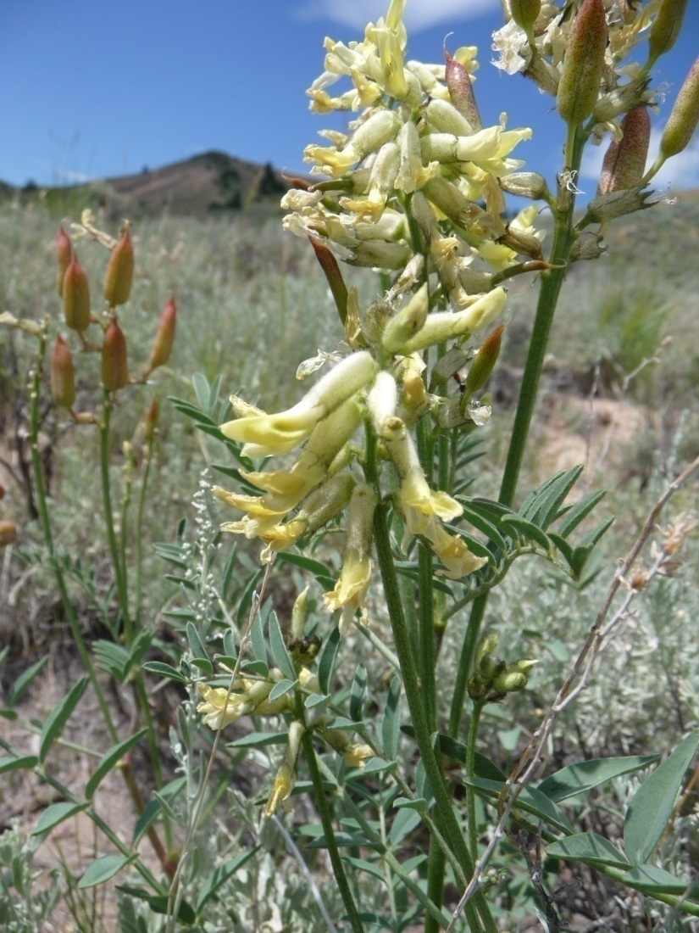
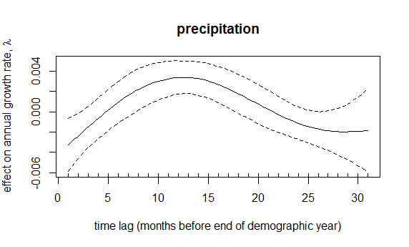
Parametric coefficients:
Estimate Std. Error
SiteDevitt 0.641305 0.388448
SiteHaynes -0.279365 0.770318
SiteReservoir 0.365343 0.837627
SiteSheep 1.062124 0.323164
SiteDevitt:year -0.009264 0.009570
SiteHaynes:year 0.036348 0.034140
SiteReservoir:year -0.007250 0.034250
SiteSheep:year -0.020101 0.009643
Reservoir Creek
Haynes Creek

